Slide 1
Securing the New Normal Virtual Event
October 2020
Notes:
Good morning and welcome to First Horizon’s Cyber Fraud virtual event – Securing the new normal.

Slide 2
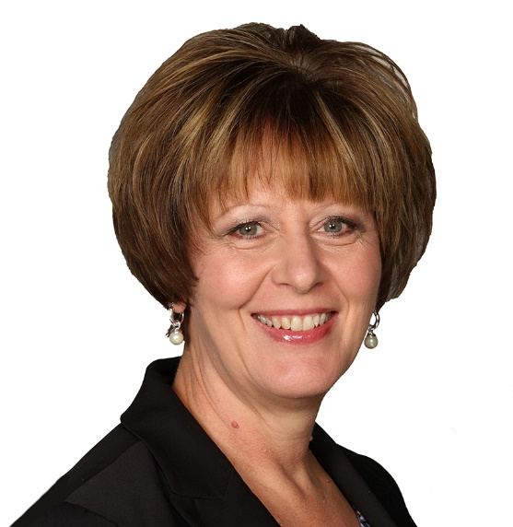
Donna Kasmiersky Executive over Treasury Management First Horizon
Welcome
Notes:
I’m Donna Kasmiersky, Executive over our Treasury Management team for First Horizon. We’re honored that you could join us today as we share our thoughts on this important and timely topic.
I’m joined today by First Horizon’s President, Specialty Banking, who will share some opening comments. Theresa Payton, leading cybersecurity expert and former White House CIO, will then share her insights and reveal the security issues hidden in you employees’ homes and how to help them work more safely.
After Theresa’s discussion, we’ll move into a Q&A session.
Steven Jones, First Horizon’s Chief Information Security Officer, will lead that segment.
Please feel free to use the Q&A box, found on the right hand side of your screen, to submit questions. Theresa will take as many as time allows.
In addition, all lines have been placed on mute and will remain so for the remainder of today’s presentation.
Today’s event is being recorded and will be forwarded to all attendees in the coming days.
I will now turn this event over to First Horizon’s President over Specialty Banking, David Popwell. David……

Slide 3
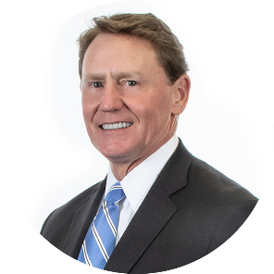
David Popwell President, Specialty Banking First Horizon
Opening Comments
Notes:
DAVID POPWELL - WELCOME
Thank attendees
Share First Horizon’s strength & stability
David will turn it back over to Donna Kasmiersky

Slide 4
Donna Kasmiersky Executive over Treasury Management First Horizon
Notes:
Thank you David.
It’s now my pleasure to welcome our keynote speaker…

Slide 5
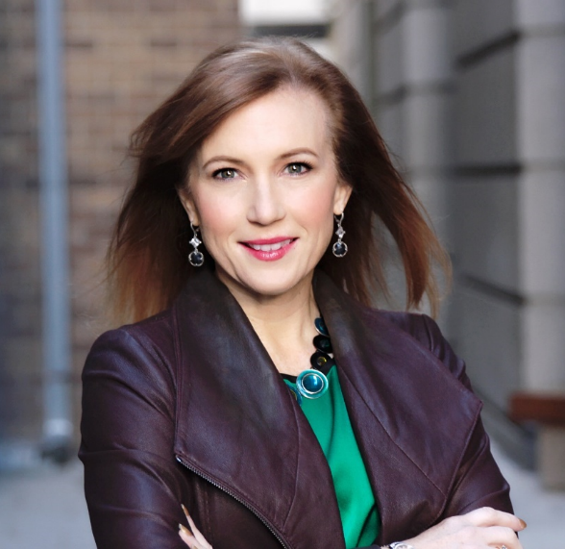
Theresa Payton Leading cybersecurity expert and former Whitehouse CIO
Keynote Speaker
Notes:
The first female to serve as White House chief information officer, Theresa Payton is one of America’s most respected authorities on cybersecurity, data breaches and fraud mitigation whose real-world strategies and solutions help public and private sector organizations protect their most valuable resources. She is a visionary in the digital world leading the way as an inventor of new security designs and has an approved US patent in security.
As Head of Intelligence on the CBS TV series, “Hunted,” Theresa and her elite team of command center investigators expose the perils and opportunities of our digital world. She is even featured in the 100 Fascinating Women Fighting Cybercrime book. The founder and CEO of cybersecurity consulting firm, Fortalice Solutions, LLC, Theresa is sought out by a wide range of organizations for her expertise in improving security systems against emerging threats.
Now she is here to reveal what we need to know today and look out for tomorrow in the ongoing battle against cybercrime.
It's now my pleasure to welcome Theresa Payton. Theresa ….

Slide 6
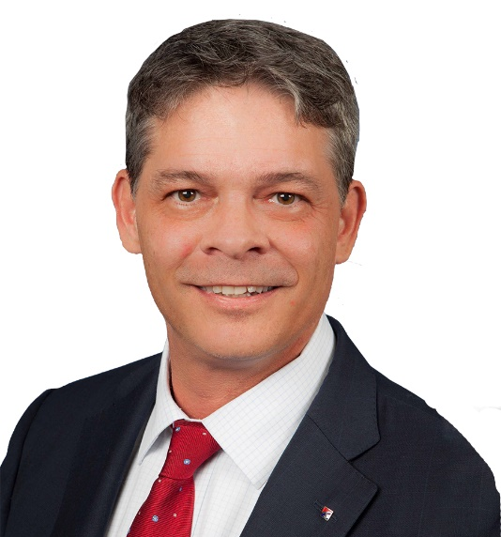
Steven Jones Chief Information Security Officer First Horizon
Q&A
Theresa Payton Leading cybersecurity expert and former Whitehouse CIO
Notes:
Steven - Thank you Theresa. We’ll now begin the Question and Answer segment of the call.
Q&A
Steven - Thank you again Theresa for your time and insights this morning. To all of our participants, thank you for your questions. We were able to answer many of them, but unfortunately, we couldn’t get to them all. If you have additional questions, please reach out to your banker.
Let me turn it over to Donna Kasmiersky to wrap up our call today.

Slide 7
Donna Kasmiersky Executive over Treasury Management First Horizon
Closing Remarks
Notes:
Thank you to our speakers and to all of you for joining us today.
As we wrap up I want to share a few best practices to ensure the information today is not just informative but actionable for you and your business.

Slide 8
What can you do to protect yourself
Diligence is your first line of defense
Conduct reconciliation of all banking transactions on a daily basis
Protect critical credentials like user ID and passwords
Immediately notify your bank of any suspicious transactions
Establish separation of duties for internal controls
Watch out for phishing, email compromise and vendor impersonation
Notes:
Did you know that NACHA, who manages and governs the Automated Clearinghouse (ACH) Network, encourages businesses to monitor their bank accounts daily as unauthorized ACH transactions can only be returned within 24 hours of receipt?
Disputes outside of the 24-hour window must be handled through the normal fraud process which costs you time and money.
Diligence is your first line of defense to protect yourself against fraud.
Monitor accounts, safeguard credentials, escalate suspicious activity - these are all examples of simple steps that cost nothing and can save your business both the time and money it takes to recover from fraud.

Slide 9
Helping to Secure Your Bottom Line
Protect against fraud with Treasury Management services designed for your business
Online Banking
ACH Positive Pay
Wire Transfer
Check Positive Pay
Account Reconciliation
Notes:
And because we understand there is more at risk than revenue, there are additional steps you can take to help secure your bottom line.
Our Treasury Management resources are designed to strengthen fraud protection. From setting transaction limits or establishing dual approvals to matching checks presented against an approved list or preventing release of wired funds outside of the U.S., we’re here to help.

Slide 10
Thank you for attending the Cyber Fraud Virtual Event
For more information, please visit:
First Horizon Bank Clients:
firsthorizon.com/fraud-protection-seminar
IBERIABANK Clients:
iberiabank.com/fraud-protection-seminar
We’re ready to help you protect your business against fraud.
Talk to your Banker or Treasury Management Sales Officer today.
Notes:
I hope you walk away with these two key points – be diligent and talk to your banker or Treasury Management Sales Officer to understand what resources are right for your business.
Thank you once again for attending today’s event. A recording of this event will be forwarded your way in the coming days.
At the conclusion of this webinar, you will see a brief 2-question survey. Please take a few moments to answer as you exit the webinar. Your responses will help us with future events.
We hope you have a great day. This now concludes this webinar. Be well.

